Slide 1


Analysis of algorithmic efficiency: Asymptotic notations and their properties
Session No.: 4 Course Name: Design and analysis of algorithms Course Code: R1UC302B Instructor Name: Rakesh Bharati Duration: 50 min Date of Conduction of Class: 28/02/2025

Slide 2
RECAP: An algorithm is a sequence of unambiguous instructions for solving a problem, i.e., for obtaining a required output for any legitimate input in a finite amount of time.

Slide 3

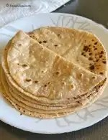

A Small Activity
G1: Write an algorithm to prepare a cup of tea
G2: Write an algorithm to prepare chapatti G3: Write an algorithm to find the gcd of 2 numbers

Slide 4


Ask Questions
Can you compare the time taken by the 3 algorithms that you have written?
How are you able to compare the time.
Discuss among your table members.

Slide 5
At the end of this session students will be able to
Learning Outcome 1: Explain the importance of analyzing algorithm efficiency.
Learning Outcome 2 : Comprehend different asymptotic notations.

Slide 6
Session Outline
1 Introduction
2. Learning activity 1
3. Concept and Definition for Learning Activity 2
4. Learning Activity 2
5. Properties of Asymptotic Notations
6. Problem Solving and Hands-On Practice

Slide 7
Introduction to algorithmic analysis
Time efficiency (time complexity): indicates how fast an algorithm runs
• Space efficiency (space complexity): refers to the amount of memory units required by the algorithm in addition to the space needed for its input and output
• Algorithms that have non-appreciable space complexity are said to be in-place
•The time efficiency of an algorithm is typically as a function of the input size (one or more input parameters).

Slide 8
Time Complexity
Time complexity of an algorithm can be calculated by
Time complexity of an algorithm can be calculated by using two methods: Posteriori Analysis Priori Analysis

Slide 9
Learning Activity 1
Look at the pesudocode for searching an element
Procedure search (list, value) { for each item in the list { if (match item == value) { return the item’s location } end if } end for } end procedure
What is the time complexity of the given searching algorithm?
Discuss In pairs.

Slide 10
Reflection- Learning Activity 1
Q1. Can you suggest a different algorithm for the same function?
Q2. How do you think it is different and how?

Slide 11
Concept and Definition for Learning Activity 2 Asymptotic Notations
The main idea is to have a measure of efficiency of algorithms that doesn’t depend on machines.
Time Complexity:
Measures the execution time of an algorithm.
Best Case (Big-Ω): Minimum time required.
Worst Case (Big-O): Maximum time required.
Average Case (Big-Θ): Expected time for random inputs.
2. Space Complexity:
Measures memory required by an algorithm.
Includes input storage, auxiliary space, and recursion stack.

Slide 12
Big-O Notation (O-notation):
Big-O notation represents the upper bound of the running time of an algorithm. Therefore, it gives the worst-case complexity of an algorithm.
It is the most widely used notation for Asymptotic analysis. It specifies the upper bound of a function. The maximum time required by an algorithm or the worst-case time complexity.
It returns the highest possible output value(big-O) for a given input.
Big-O(worst-case) It is defined as the condition that allows an algorithm to complete statement execution in the longest amount of time possible.

Slide 13
If f(n) describes the running time of an algorithm, f(n) is O(g(n)) if there exist a positive constant C and n0 such that, 0 ≤ f(n) ≤ cg(n) for all n ≥ n0

Slide 14
Omega Notation (Ω-Notation):
Omega notation represents the lower bound of the running time of an algorithm. Thus, it provides the best-case complexity of an algorithm.
The execution time serves as a lower bound on the algorithm’s time complexity.
It is defined as the condition that allows an algorithm to complete statement execution in the shortest amount of time.

Slide 15
Let g and f be the function from the set of natural numbers to itself. The function f is said to be Ω(g), if there is a constant c > 0 and a natural number n0 such that c*g(n) ≤ f(n) for all n ≥ n0

Slide 16
Theta Notation (Θ-Notation):
Theta notation encloses the function from above and below. Since it represents the upper and the lower bound of the running time of an algorithm, it is used for analyzing the average-case complexity of an algorithm.
Theta (Average Case) You add the running times for each possible input combination and take the average in the average case.

Slide 17
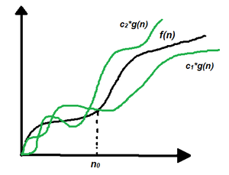
Let g and f be the function from the set of natural numbers to itself. The function f is said to be Θ(g), if there are constants c1, c2 > 0 and a natural number n0 such that c1* g(n) ≤ f(n) ≤ c2 * g(n) for all n ≥ n0

Slide 18
Learning Activity 2
Group1: Bubble sort
Group 2: Selection sort
Group 3: Quick Sort
Take 3-4 minutes of your time and analyse the best and worst time complexity of these sorting algorithms.

Slide 19
Reflection- Learning Activity 2
What will happen if the input size vary in all the algorithms?
Does the time complexity also depend on the input size?

Slide 20
Properties of Asymptotic Notations:
General Properties:
If f(n) is O(g(n)) then a*f(n) Is also O(g(n)), where a is a constant.
Transitive Properties: If f(n) is O(g(n)) and g(n) is O(h(n)) then f(n) = O(h(n))
Reflexive Properties:
Reflexive properties are always easy to understand after transitive. If f(n) is given then f(n) is O(f(n)).
Since MAXIMUM VALUE OF f(n) will be f(n) ITSELF!

Slide 21
Properties of Asymptotic Notations:
Symmetric Properties: If f(n) is Θ(g(n)) then g(n) is Θ(f(n))
Transpose Symmetric Properties: If f(n) is O(g(n)) then g(n) is Ω (f(n))

Slide 22
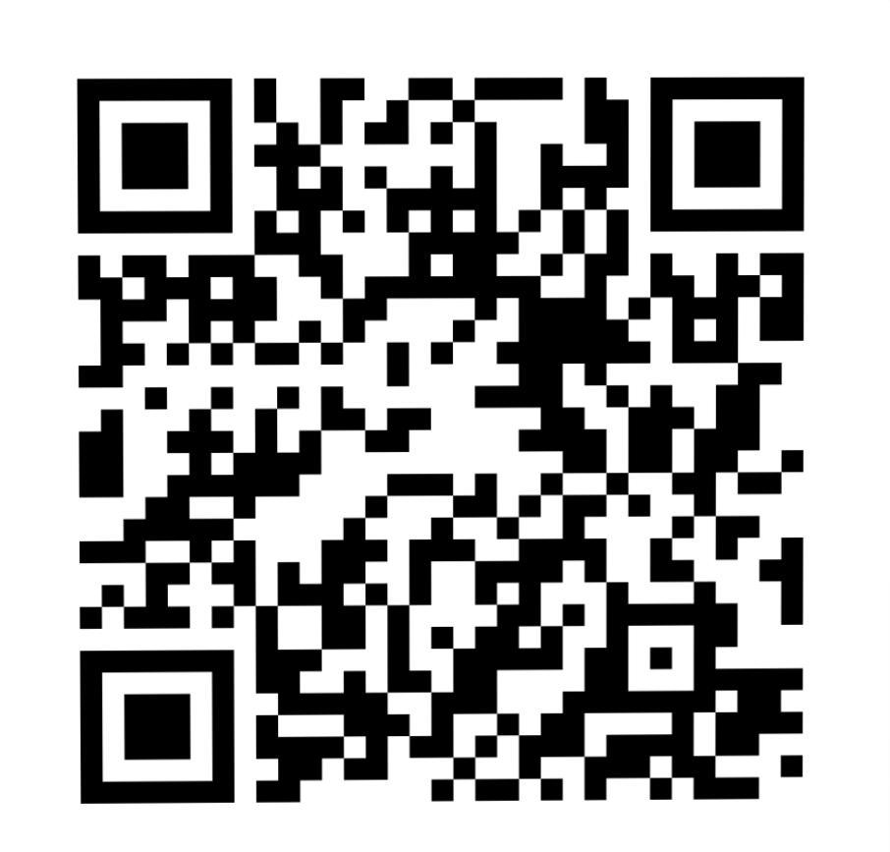
Problem Solving and Hands-On Practice
Take this 5 minutes quiz for better understanding
Participation Link –
https://app.wooclap.com/PAALXO?from=instruction-slide
You can also join using woo lap code - PAALXO

Slide 23
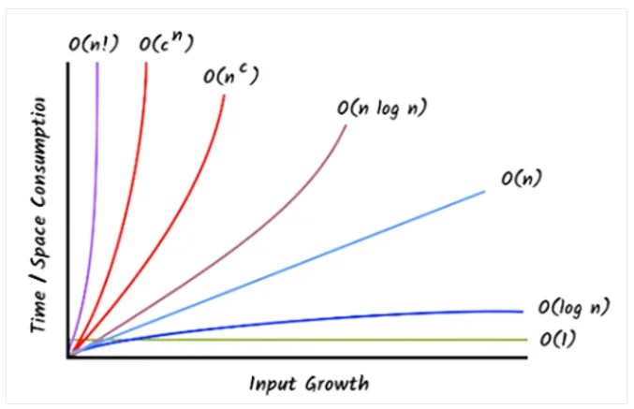
Summary

Slide 24
Discussion on the post session activities
Ask your doubts

Slide 25
Information about the next lesson
Complexity Analysis of Non-Recursive Algorithms
(examples: max, sum, matrix operations)

Slide 26

Review and Reflection from students
Provide your feedback on analysis of algorithms effeciency session.

